Slide 1



Running Linux in Azure and other cool things
Alexey Bokov
Windows Azure evangelist
abokov@microsoft.com
azure_cee

Slide 2

Topics:
Azure Cloud
PHP and Websites
Traffic Manager
Linux and Puppet
Port your app to NokiaX

Slide 3

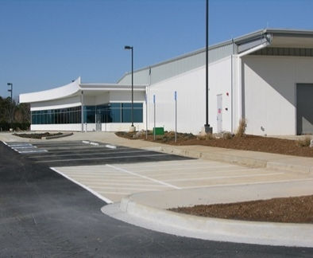


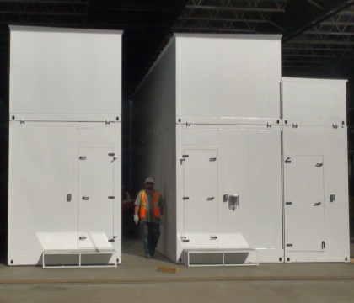

kr
kr
$
€
руб
£
chf
$
₩
¥
TL
$
Global datacenters
Global CDN
Global support
Rp
Local account teams
$
R
Local currencies - RON
$
$
24 x 7 x 365 support Over 1 billion customers, 20 million businesses 76 markets worldwide
280 years of combined industry experience in infrastructure, security, product dev, and global ops
Notes:
Lets now take a look at the global scale at which Microsoft Azure operates.
We operate in 12 global regions across different contents. 4 in US, 2 in Europe, and 6 in Asia. These are gigantic in their scale and operations and here are some of the pictures.
We are currently offering preview access to the datacenter in Brazil
The Australia datacenters will become available before the end of this calendar year.
In addition, we have 29 CDN locations across the globe.
We provide support across 109 countries and in 8 languages
We have our local teams and sales offices across the world.
In addition, we have 19 countries with local currency support

Slide 4

By the Numbers
Jan 2014
300,000
55% of the Fortune 500 companies
Notes:
1,000 new customers per day
1,000,000 cores milestone achieved September last year
1.6 Hexabyte milestones achieved at the end of last year

Slide 5
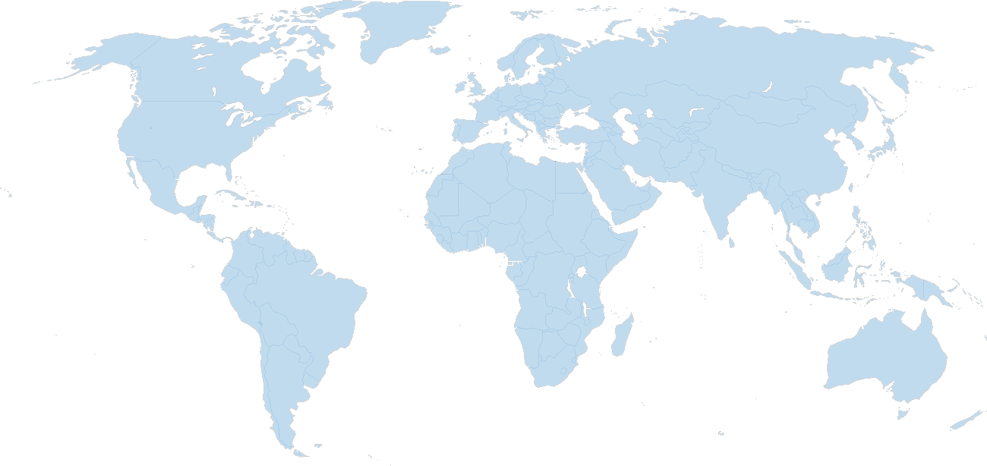


Microsoft Azure : 13 datacenter locations, including China
East US
North Europe/ Dublin
Japan East/ Saitama
West US
China South+North/
Vianet21
West Europe/ Amsterdam
North Central US
South Central US
Japan West / Osaka
East Asia /Hong Kong
South East Asia/ Singapore
13 datacenters
- 4th generation ITPAC
- size ~ 28 100 sq.meter
- power ~ 16 MWt
- PUE ~ 1.05-1.22
- cost ~ 500М $
Brazil South / San Paulo (preview)
Notes:
1,000 new customers per day
1,000,000 cores milestone achieved September last year
1.6 Hexabyte milestones achieved at the end of last year

Slide 6

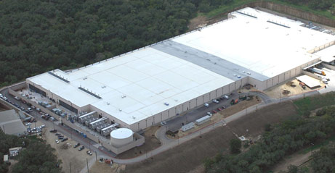
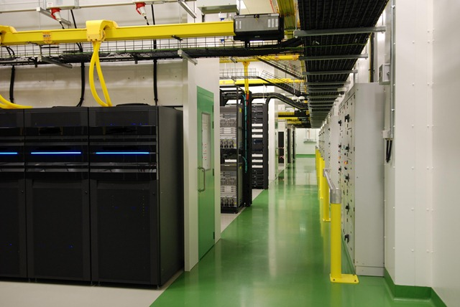
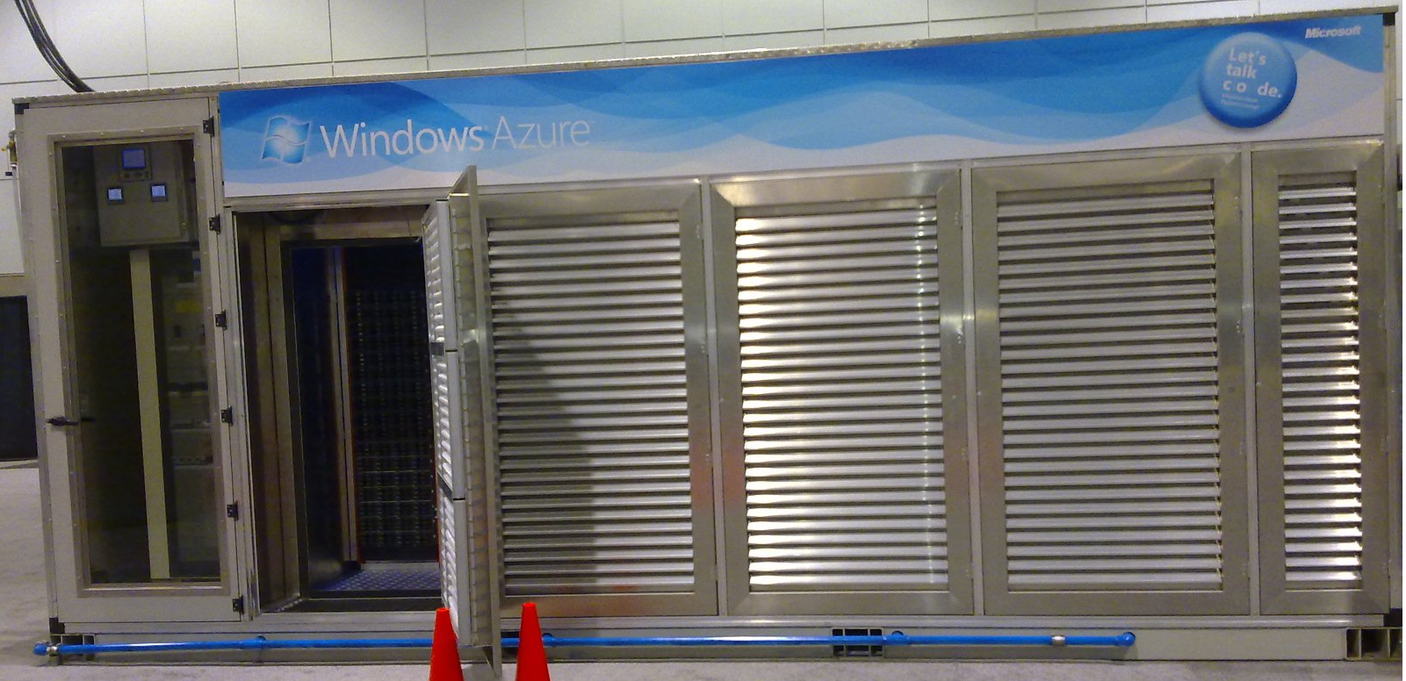
Azure datacenters
Tour to Datacenter: aka.ms/gfs-video

Slide 7
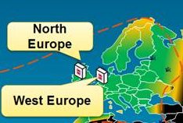
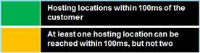
Latency in Europe
Notes:
1,000 new customers per day
1,000,000 cores milestone achieved September last year
1.6 Hexabyte milestones achieved at the end of last year

Slide 8
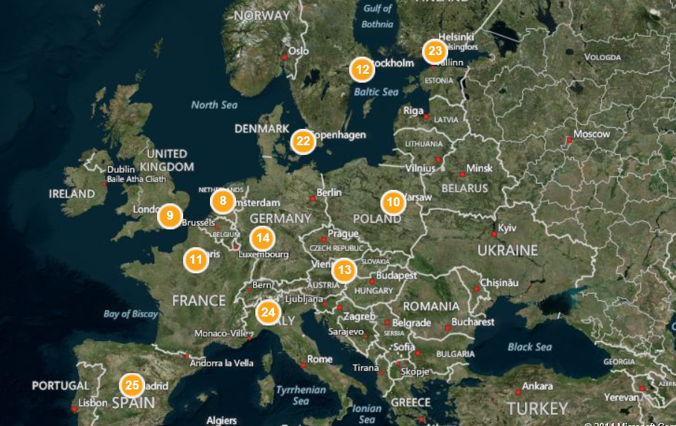
Global Azure Content Delivery Network
Node locations list on world map
aka.ms/cdn-map
29 CDN nodes: Atlanta, Miami, NY, Washington DC, Chicago, Dallas, Los Angeles, San Jose, Seattle, Copenhagen, Helsinki, Stockholm, Vienna, Warsaw, Amsterdam, Frankfurt, Milan, London, Madrid, Paris, Batam, Hong Kong, Jakarta, Kaohsiung, Singapore, Melbourne, Sydney, Tokyo, Osaka

Slide 9

Want to try ?
Free 30 days trials on azure.com
2 year free trial for MSDN members
3 year free trial for BizSpark member
– each BizSpark trial includes 8 MSDN subscriptions
You may try to get Windows Azure Offer $5K/mo for 1 year ( BizSpark+)
25% discount to MSDN members for out-of-limit Azure usage
Discounts via Enterprise Agreements with Microsoft
”Boost your startup with Microsoft Ventures” by Zoli Herczeg – 10AM, tomorrow, here on #topconfro

Slide 10
Microsoft program for startups : BizSpark
Tomorrow 10AM: ”Boost your startup with Microsoft Ventures” by Zoli Herczeg
Easy to register – bizspark.com
3 year free trial for member
– each BizSpark trial includes 8 MSDN subscriptions
You may try to get Windows Azure Offer $5K/mo for 1 year ( BizSpark+)

Slide 11
Case studies
aka.ms/azure-cases
Just a few of them is:
Olympic games 2014 – we developed and host sochi2014.com, provide online streaming for NBC Sports
Xbox games – most of games are back-end on Azure – like Titanfall, Xbox team is biggest internal customer
The Romanian Ministry of Education via Siveco uses Azure for high school admission application, ADLIC, which is used to publish high school entry test scores.

Slide 12


We have changed as a company and have become more OPEN
Notes:
<choose from slides 3 – 10 as alternative intro pictures>
Timing: 1 minute
Key Points:
Microsoft has changed as a company and become more open.
Script:
Microsoft has changed as a company and become more open. The old debate – black or white; open source or commercial software; us versus them – is simply no longer relevant. Today, many customers manage mixed IT environments. And they have told us that what matters today is maximizing their existing IT investments while having the freedom to choose new solutions that best support their business goals. To meet these customer needs, Microsoft is committed to openness.

Slide 13

We have changed as a company and have become more OPEN
Notes:
<choose from slides 3 – 10 as alternative intro pictures>
Timing: 1 minute
Key Points:
Microsoft has changed as a company and become more open.
Script:
Microsoft has changed as a company and become more open. The old debate – black or white; open source or commercial software; us versus them – is simply no longer relevant. Today, many customers manage mixed IT environments. And they have told us that what matters today is maximizing their existing IT investments while having the freedom to choose new solutions that best support their business goals. To meet these customer needs, Microsoft is committed to openness.

Slide 14

We have changed as a company and have become more OPEN
Notes:
Timing: 1 minute
Key Points:
In summary, we have changed as a company and have become more open.
Script:
So, if you look at it in terms of: playing well with others, listening to customers, and being open in the cloud – you can see Microsoft has changed as a company and become much more open.

Slide 15
Lucian demo and slides
Notes:
1,000 new customers per day
1,000,000 cores milestone achieved September last year
1.6 Hexabyte milestones achieved at the end of last year

Slide 16
Scaling PHP applications using Azure Websites
Lucian Daia, Lead Software Engineer @ Zitec

Slide 17
Azure Websites overview
PaaS service offered by Microsoft Azure
Windows Server + IIS
PHP, Java, Python, NodeJS and .NET support
Deploy code using Git, Github, Dropbox, FTP, etc.
High availability built-in!
Seamless scaling up and down
For full customization, check out Azure Linux VMs!

Slide 18
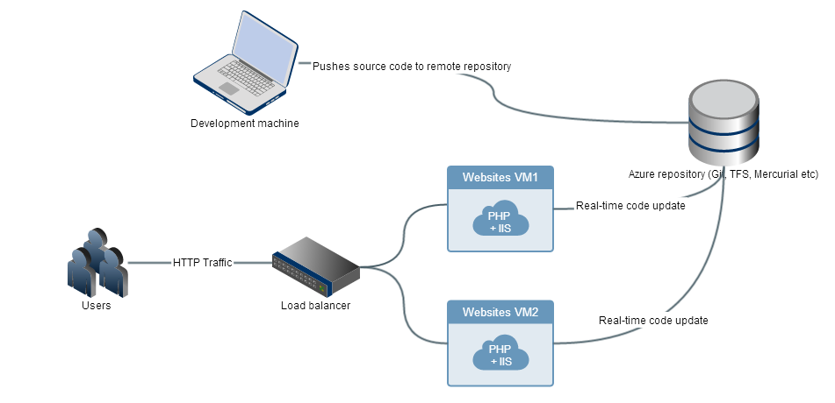
Azure Websites architecture

Slide 19
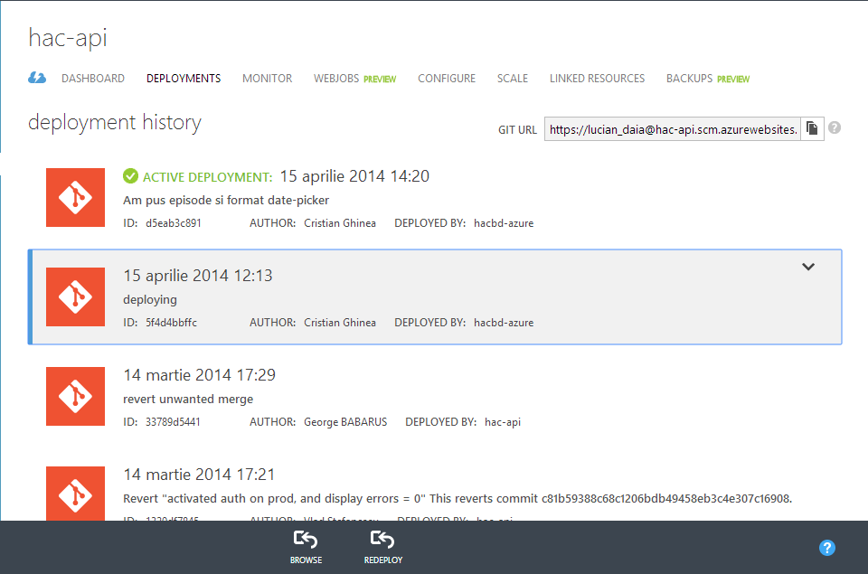
Application deployment using Git
Publish using
Azure-hosted Git
Github
Bitbucket
Dropbox
FTP
Or just edit online!
Revert to previous builds

Slide 20
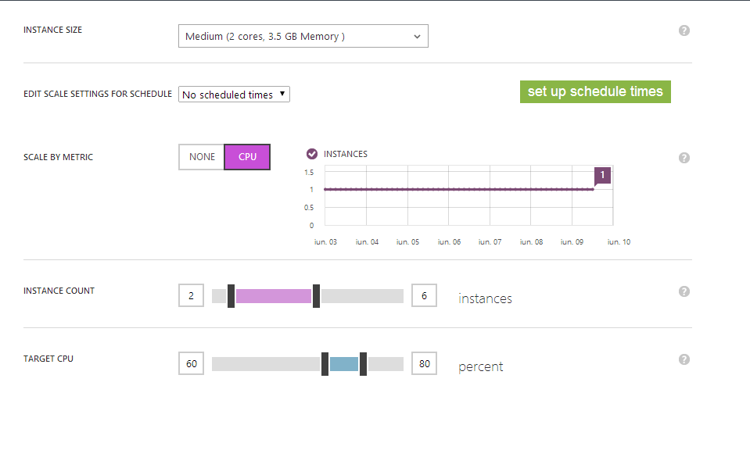
Scaling your application
Scale on-demand
Or let Azure scale it for you
From free shared hosting
Up to 10 dedicated machines!

Slide 21
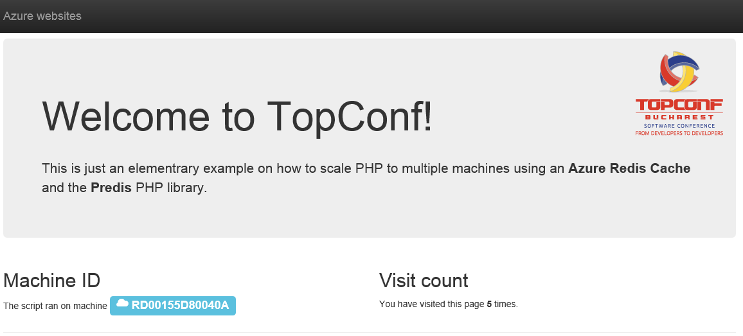
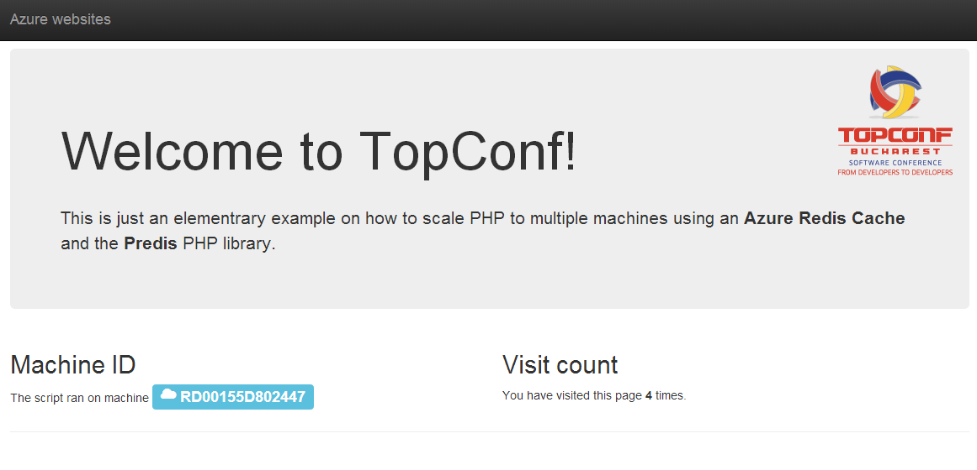
Example PHP application scaling
Having a central session store allows you to preserve user experience

Slide 22
Good practices
Store sessions in a central store – try the Azure Redis Cache!
Store all user uploads in a central store – Azure Blobs
Make sure your datastore is scalable and highly available
Might get tricky for relational databases
Find out more about how to scale both PHP and MySQL tomorrow at the workshop
Got a small application you want to make highly available? We’ll cover that!
Got a huge app that needs a large MySQL cluster? We’ll cover that too!

Slide 23
Azure Traffic Manager demo

Slide 24
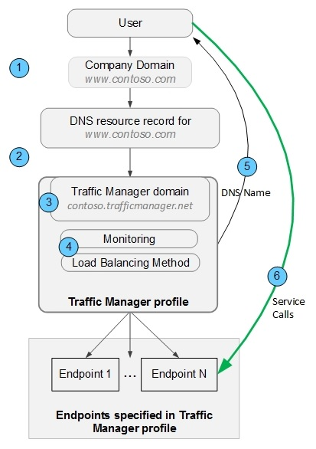
Traffic Manager – how it works ?
Notes:
1,000 new customers per day
1,000,000 cores milestone achieved September last year
1.6 Hexabyte milestones achieved at the end of last year

Slide 25

Use Azure to load
Balancing (round robin)
cloudtechnologies.org
ou.gs (198.12.153.248 )
GoDaddy hosting
topconf.trafficmanager.net
Mode: roundrobin
topconf2.cloudapp.net
Microsoft Azure hosting
Notes:
1,000 new customers per day
1,000,000 cores milestone achieved September last year
1.6 Hexabyte milestones achieved at the end of last year

Slide 26

Use Azure as disaster recovery for your site
cloudtechnologies.org
ou.gs (198.12.153.248 )
GoDaddy hosting
topconf.trafficmanager.net
Mode: Failover
topconf2.cloudapp.net
Microsoft Azure hosting
Notes:
1,000 new customers per day
1,000,000 cores milestone achieved September last year
1.6 Hexabyte milestones achieved at the end of last year

Slide 27

Yes, it works!!!!

Slide 28

Traffic Manager - pricing model
First 1 billion DNS queries /month | $0.75 per million queries
Over 1 billion DNS queries / month | $0.375 per million queries
Health Checks (Azure) | $0.50 per Azure endpoint / month
Health Checks (External) | $0.75 per External endpoint / month

Slide 29
Thomas Conte slides

Slide 30
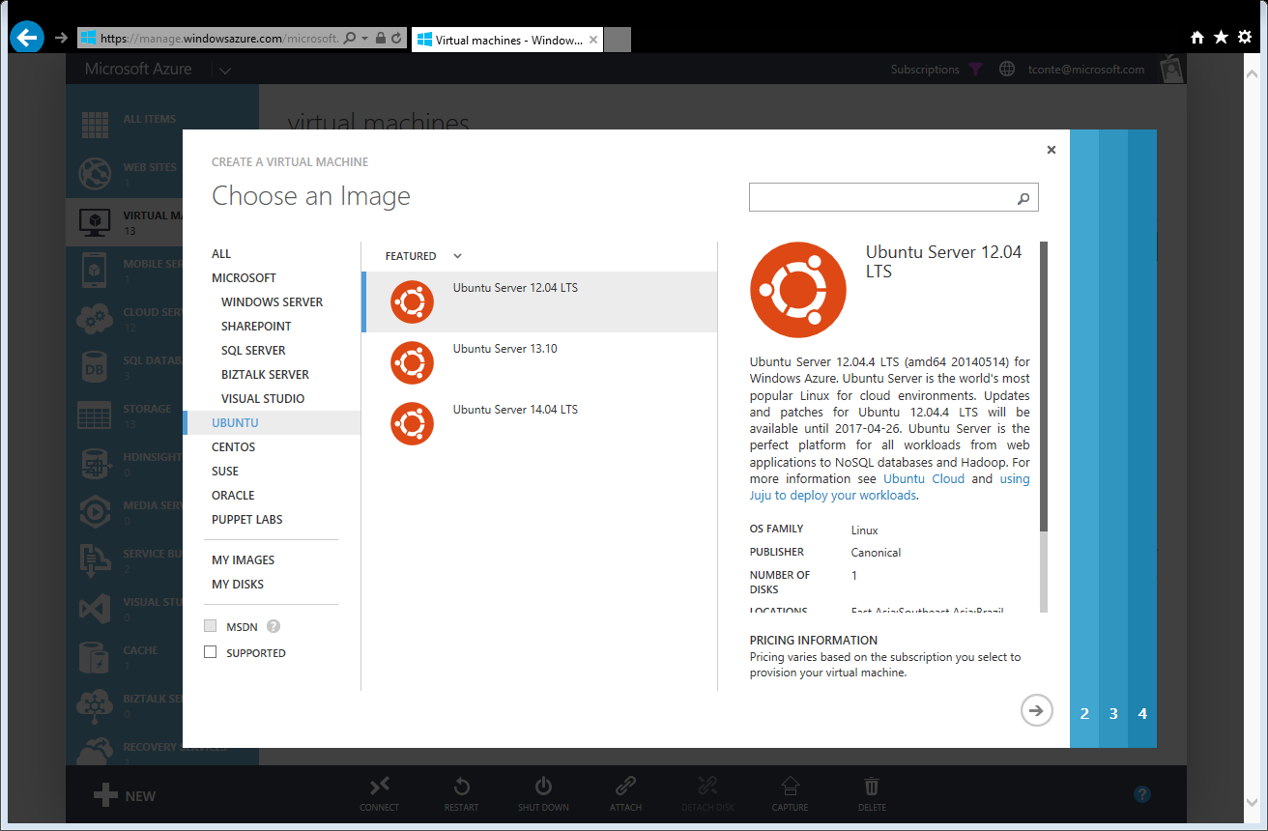

Slide 31
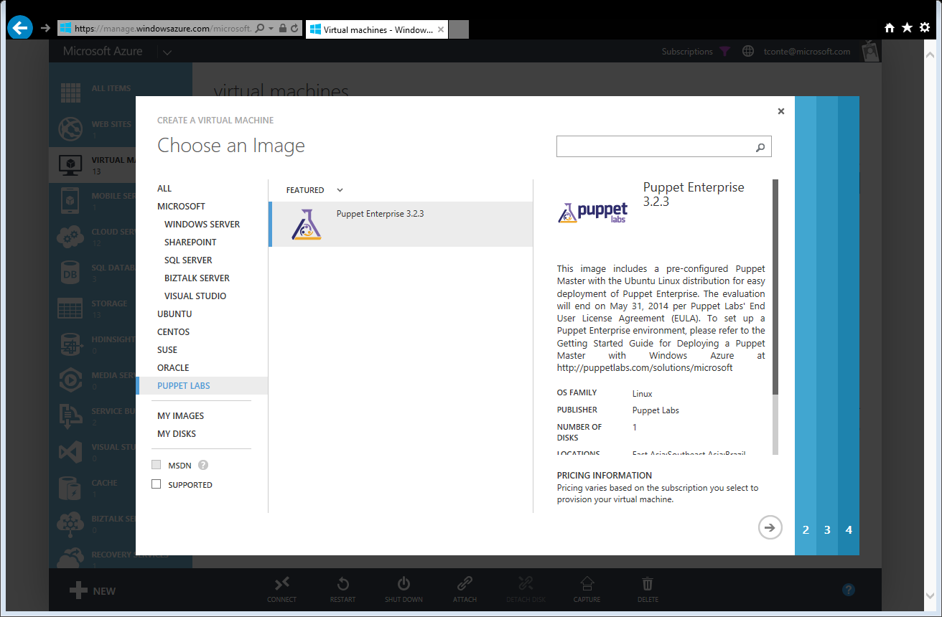

Slide 32
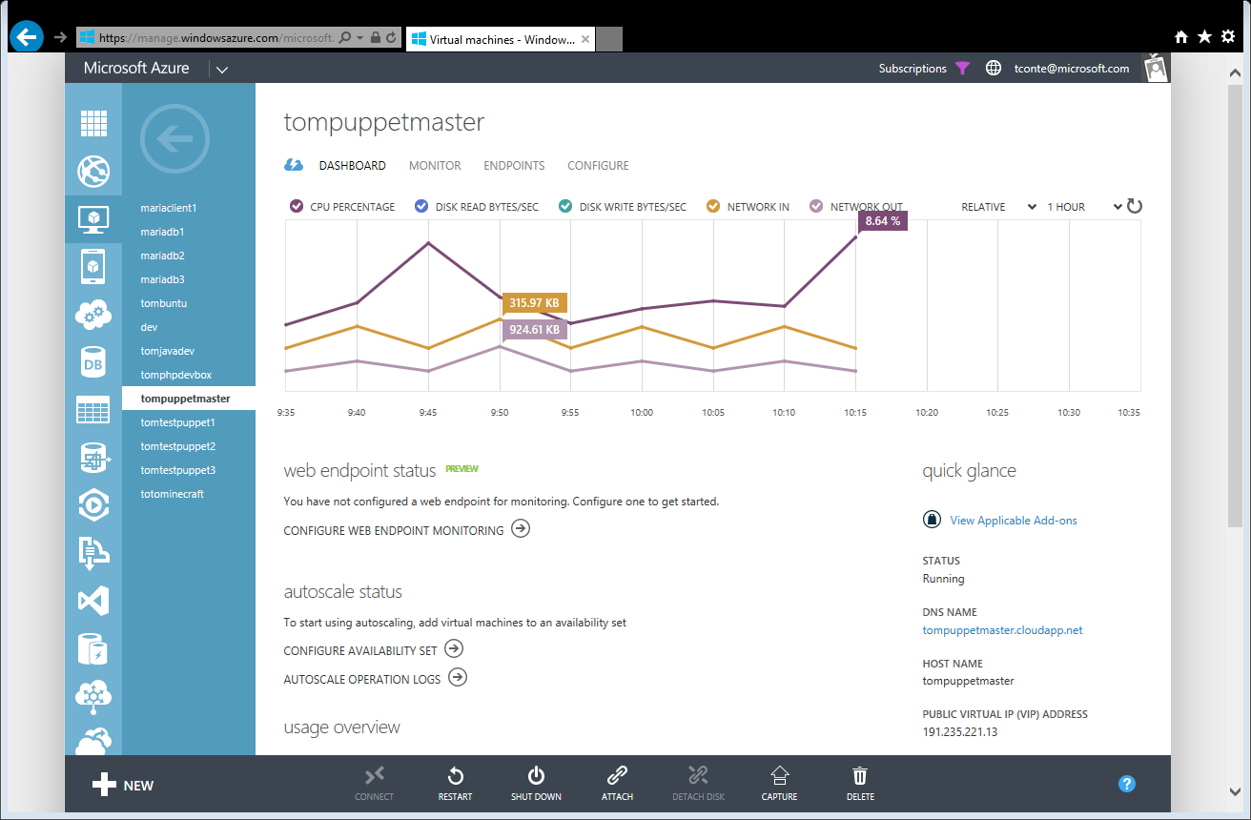

Slide 33
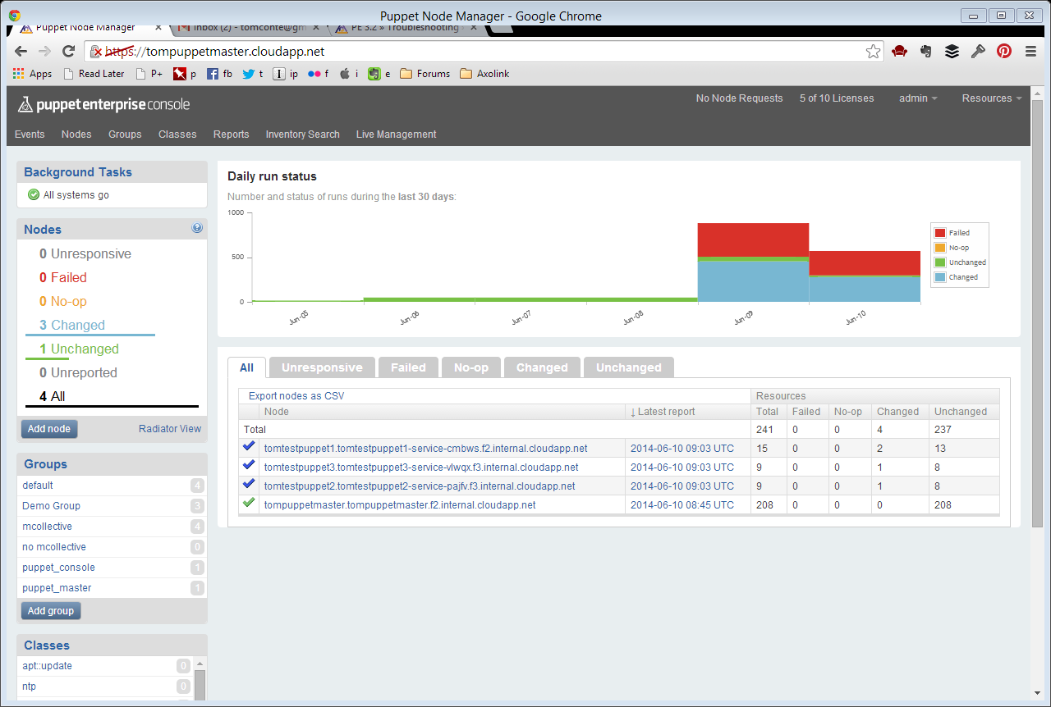

Slide 34
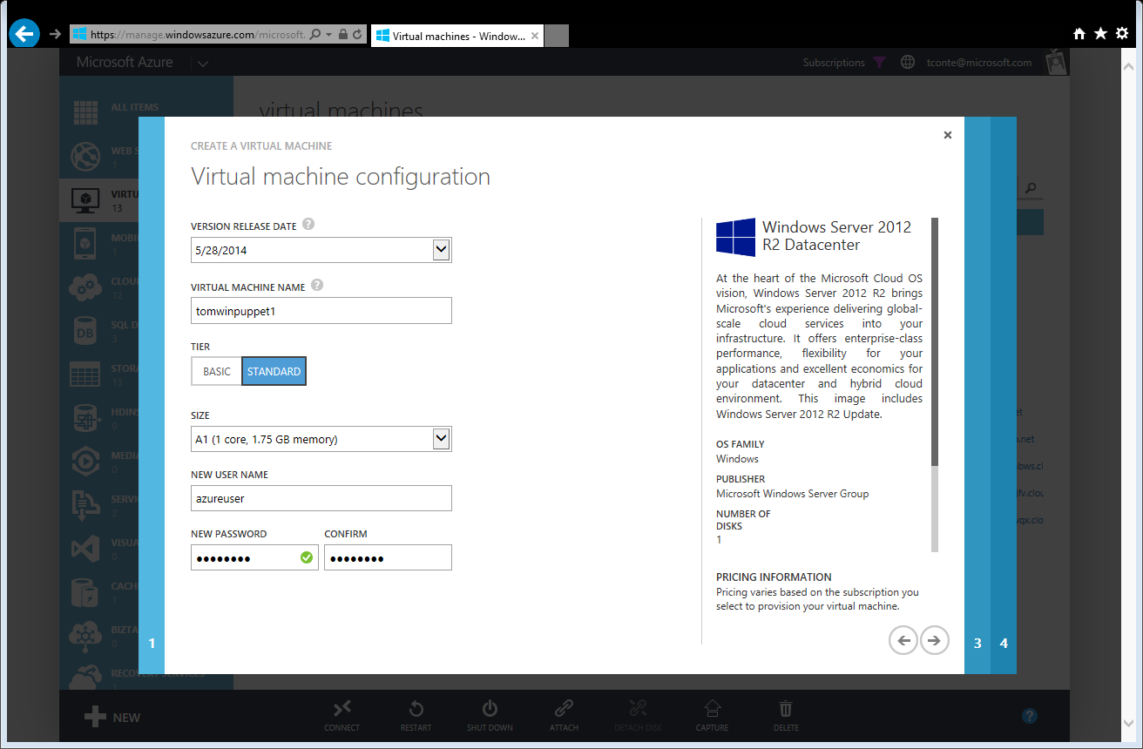

Slide 35
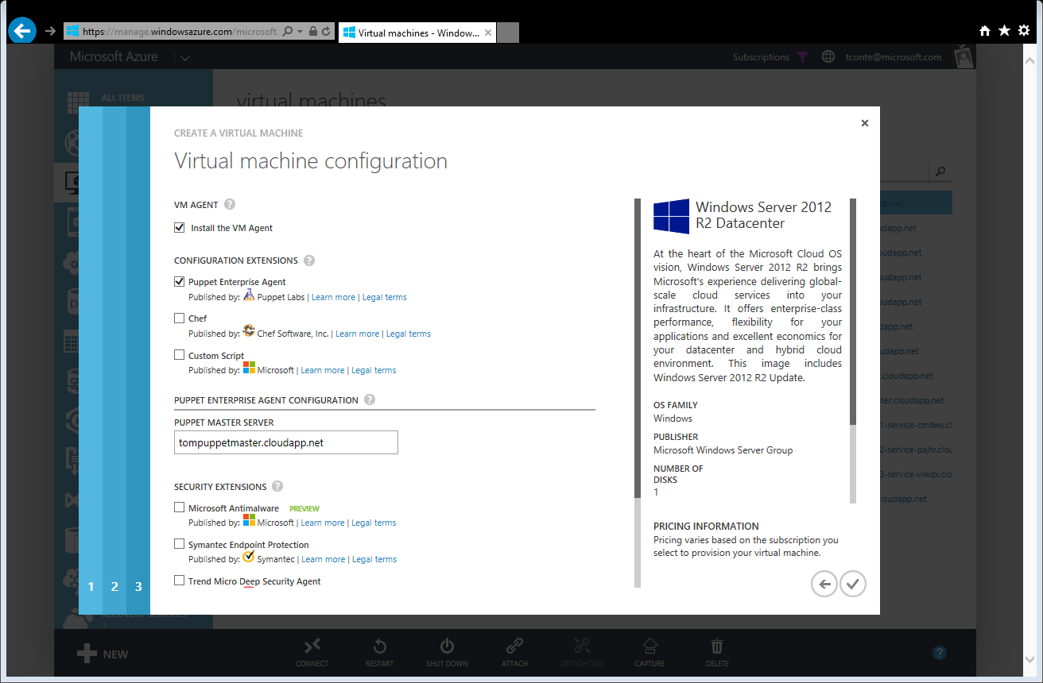

Slide 36
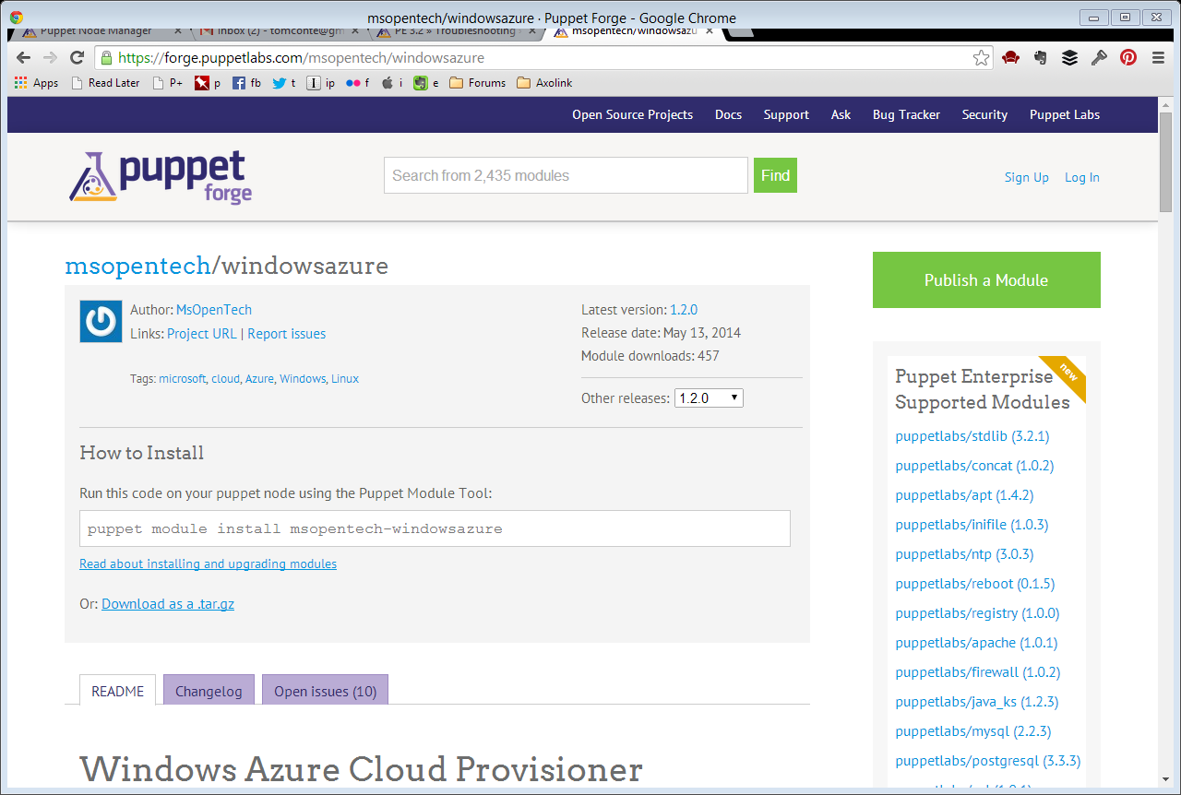

Slide 37
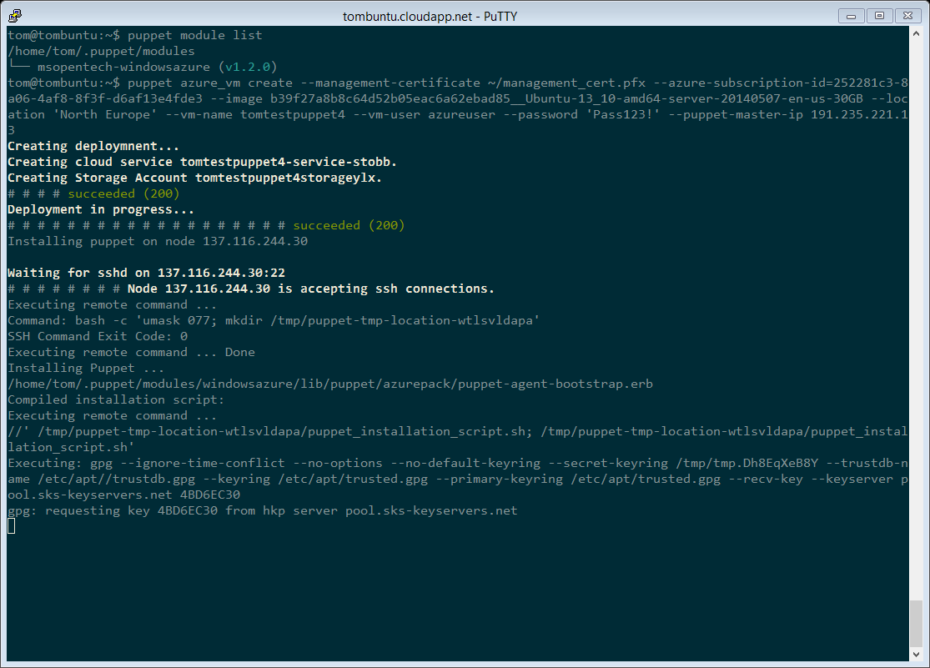

Slide 38
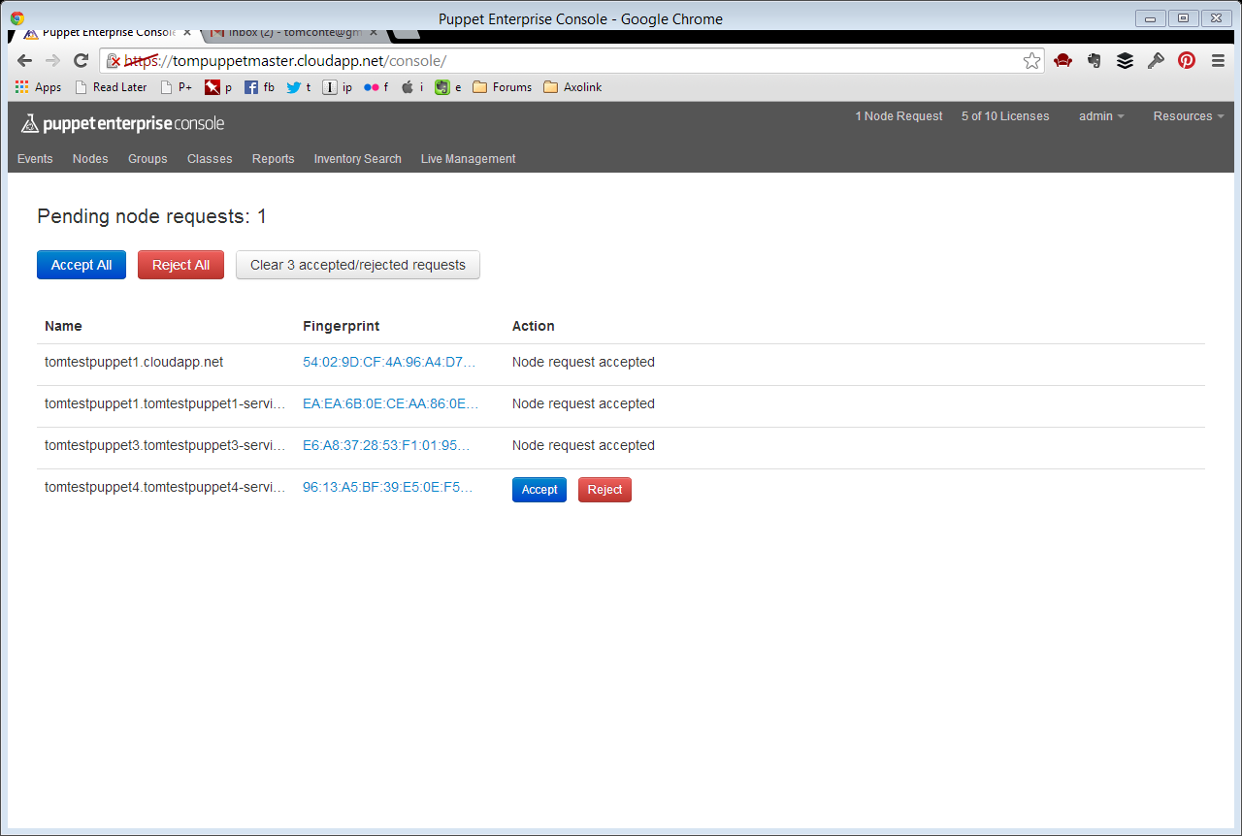

Slide 39
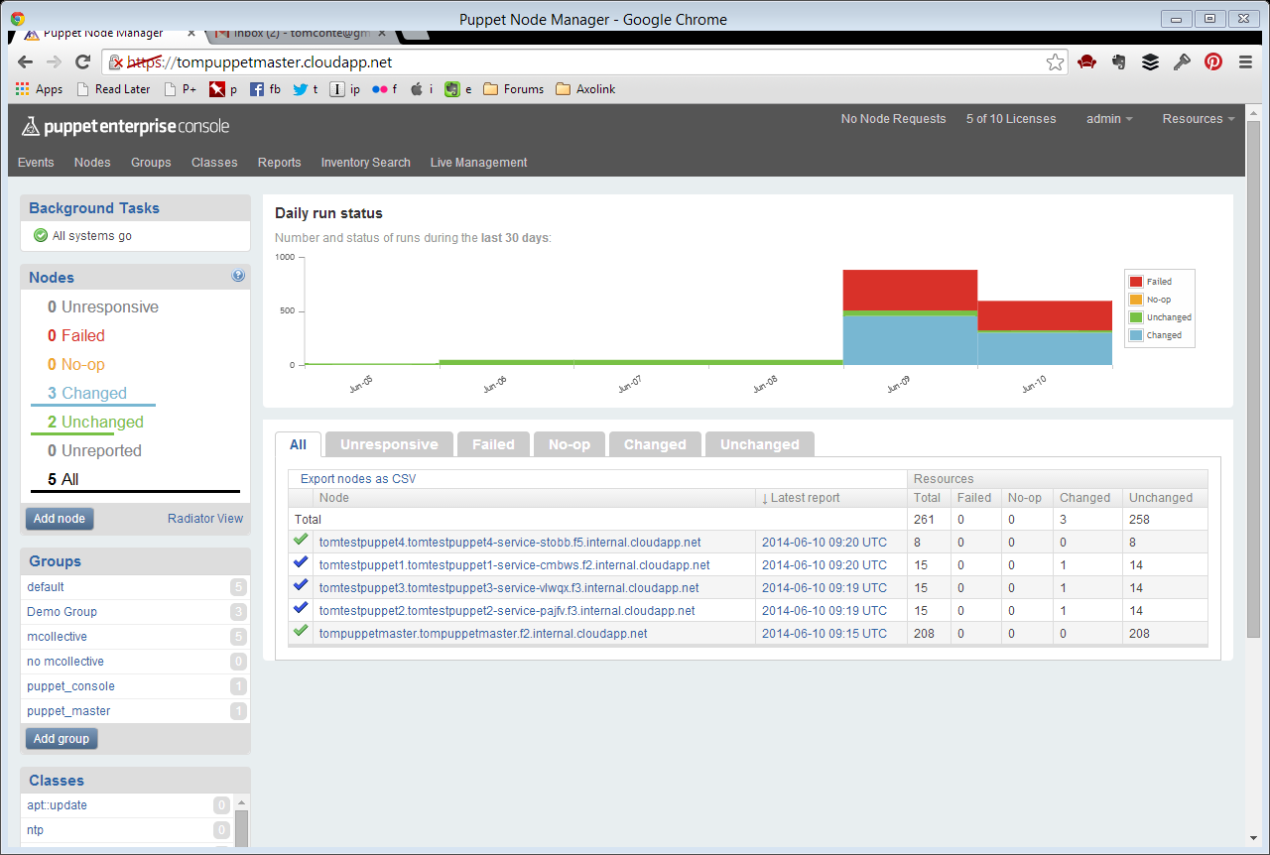

Slide 40
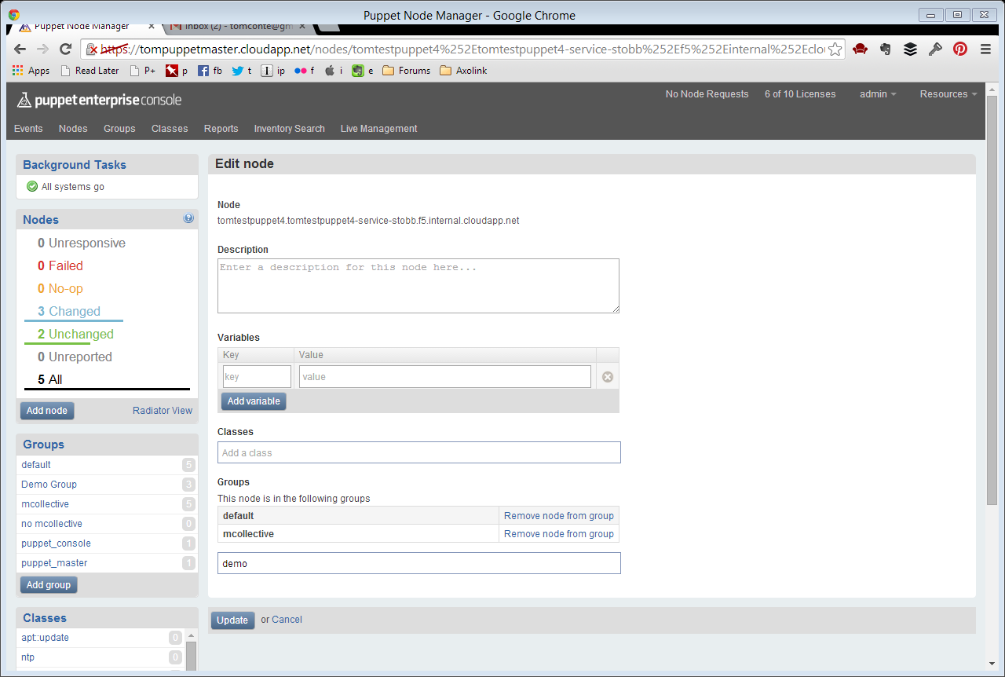

Slide 41
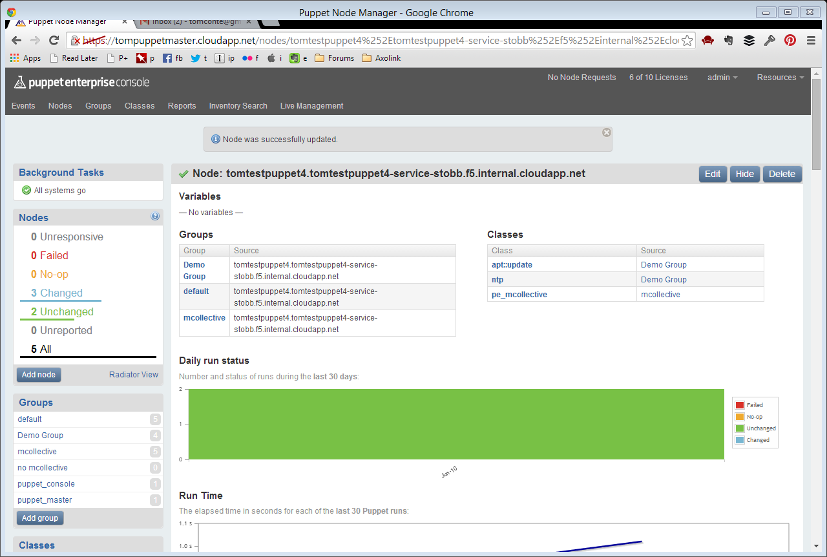

Slide 42
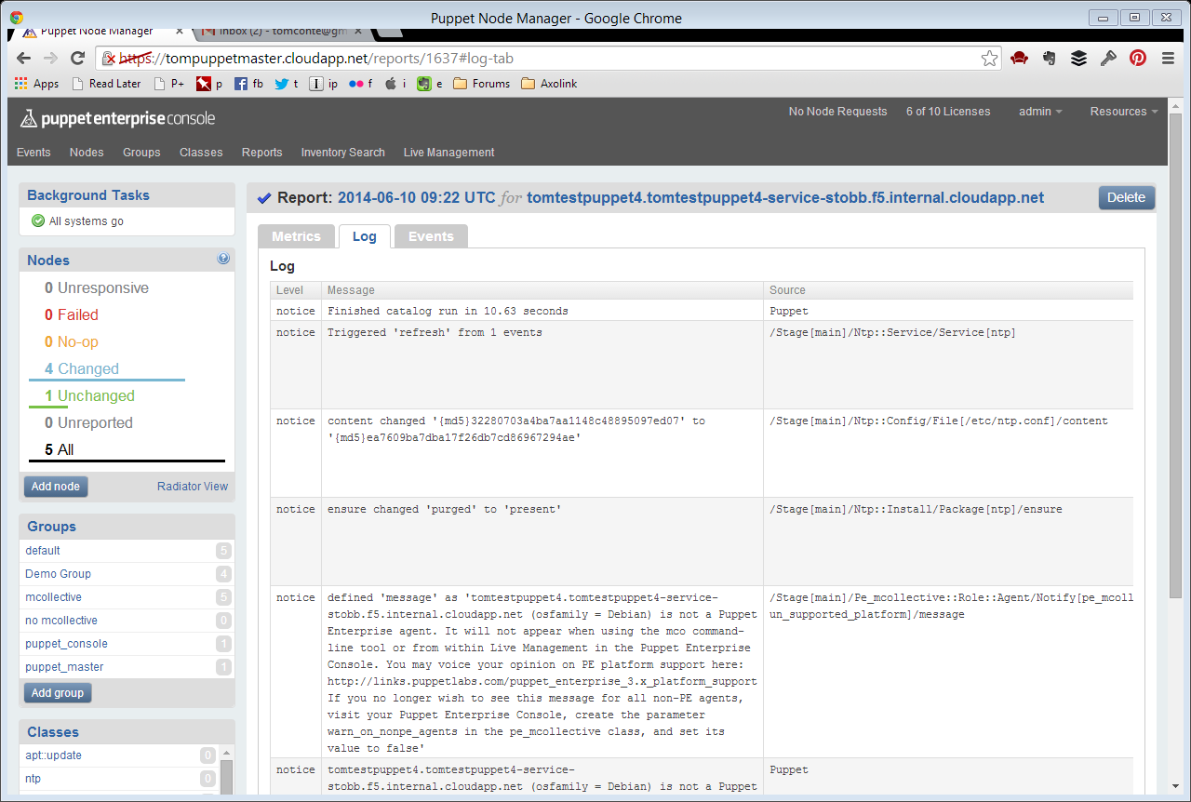

Slide 43
Thomas Conte slides

Slide 44
Live demo with Traffic Manager

Slide 45

Your own linux in Azure ?
Yes,if HyperV supports this
What you need is to add Linux agent to your disto.
Linux agent responsible for interacting with Windows Azure Fabric Controller
Manual: aka.ms/agent
Notes:
1,000 new customers per day
1,000,000 cores milestone achieved September last year
1.6 Hexabyte milestones achieved at the end of last year

Slide 46
Nokia Slides

Slide 47
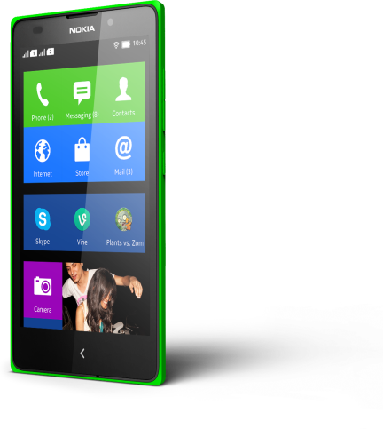
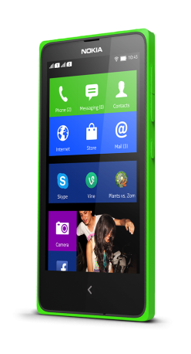
449
RON
Available soon!!
4” WVGA
Dual Core 1ghz Snapdragon
5” WVGA
5MP auto focus
2MP front facing
NokiaX
NokiaXL
Notes:
The three initial members of the Nokia X family have a clear “pay more get more” logic, starting at just €89 estimated retail price excluding taxes and subsidies.
Among key device features include:
Nokia X: 4-inch display, Dual core snapdragon processors
Users upgrading to the X+ will benefit from faster and smoother multitasking, with more storage for their favorite media
XL customers will enjoy an even larger 5” display, improved camera and a front facing camera ideal for those Skype video calls with a unique offer together with Microsoft of a month free Skype calls for Nokia X users
All 3 Nokia X devices are available in DUAL SIM – popular in emerging markets.

Slide 48













































































Nokia X provides access to the world of Android APPS

Slide 49





















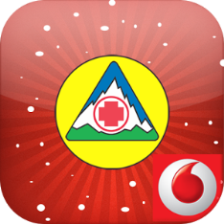



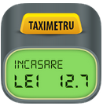



Romanian Apps in Nokia Store!

Slide 50



Nokia X Compatibility, it’s a no brainer
Nokia testing has shown that about 75% of Android apps will run properly without any modifications. Plus we give you easy to use online and offline tools to check your applications within seconds.
Nokia X Analyzer developer.nokia.com
75% work
unmodified
25% need
a little retouch
Submit .apk to
Nokia Store
Port using
Nokia X
Services SDK
Up to
8h porting*
*For most apps, depending on application complexity and number of used APIs that need porting

Slide 51
Nokia X Verify general compatibility
Check if your Android app is compatible with Nokia X software platform IN SECONDS.
Provide quick and easy porting steps highlights common failure cases for easy porting.
Analyzer UI
Nokia X Analyzer scans the standard Android application packages (apk files).
Based on the above APIs’ usage, the application is flagged as compatible or not.
Failure cases are surfaced to developers with pointers to fix using SDK plugins
Android app (.apk) parser
Analyzer Rules Engine
G maps to Here maps
G notifications to NNA
G billing to NIAP
NFC
API Level
Nokia X Analyzer engine is verified with 10K Android apps with 99% accuracy!

Slide 52
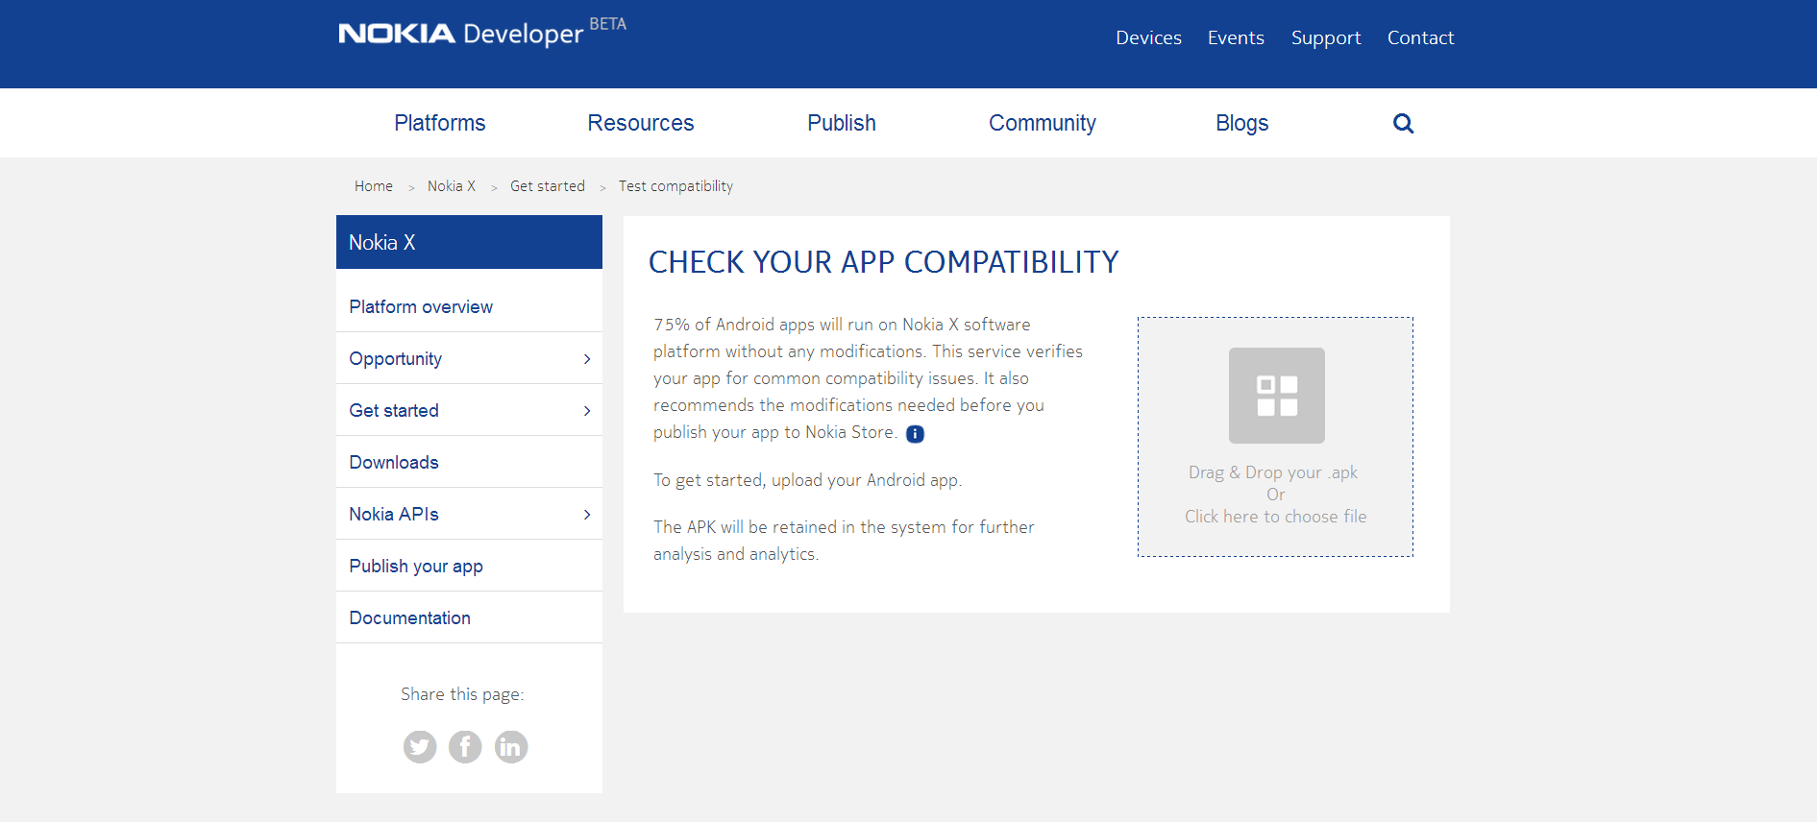

Slide 53
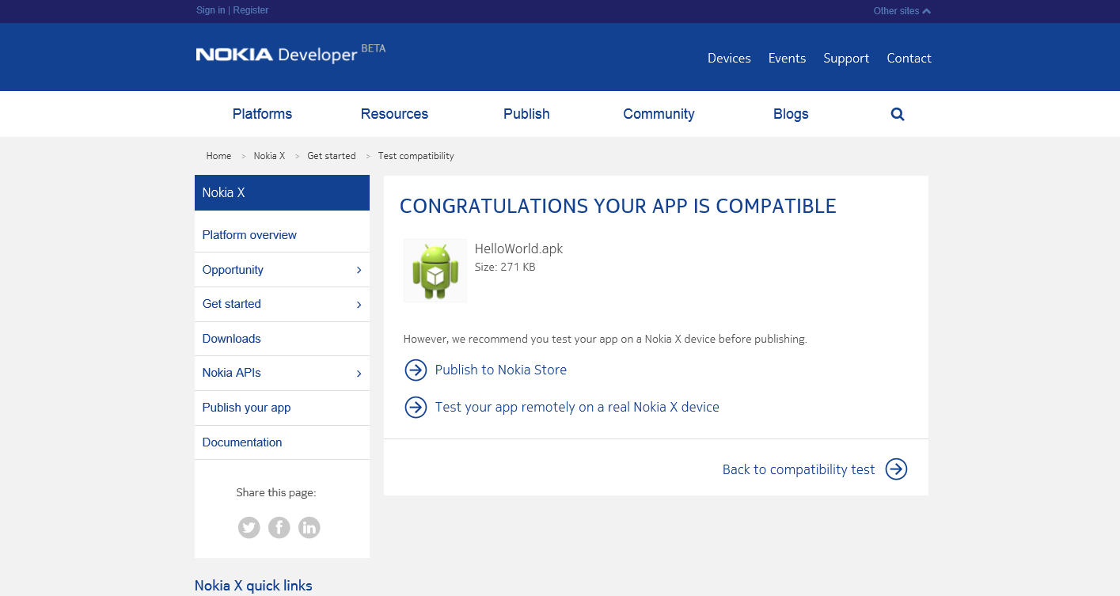

Slide 54
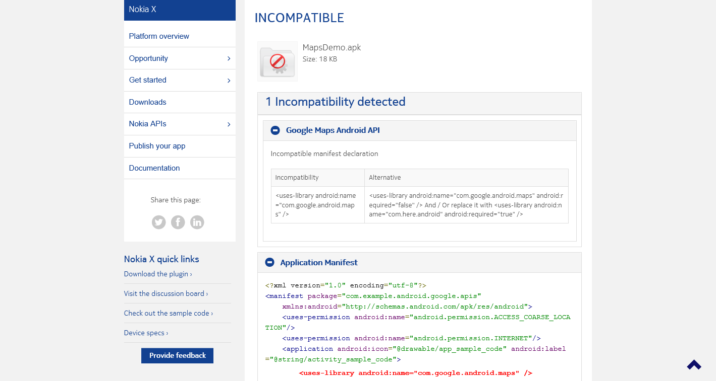

Slide 55
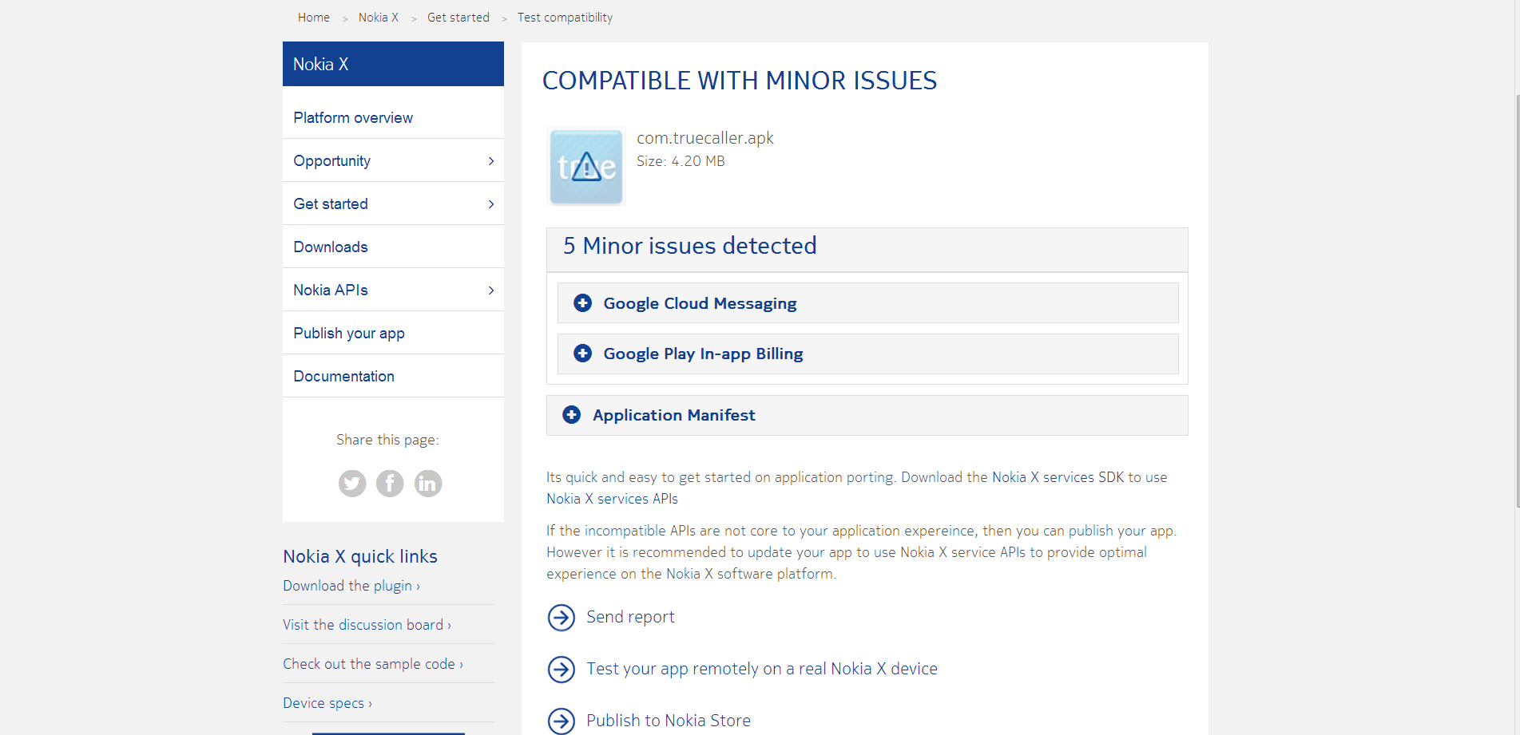

Slide 56
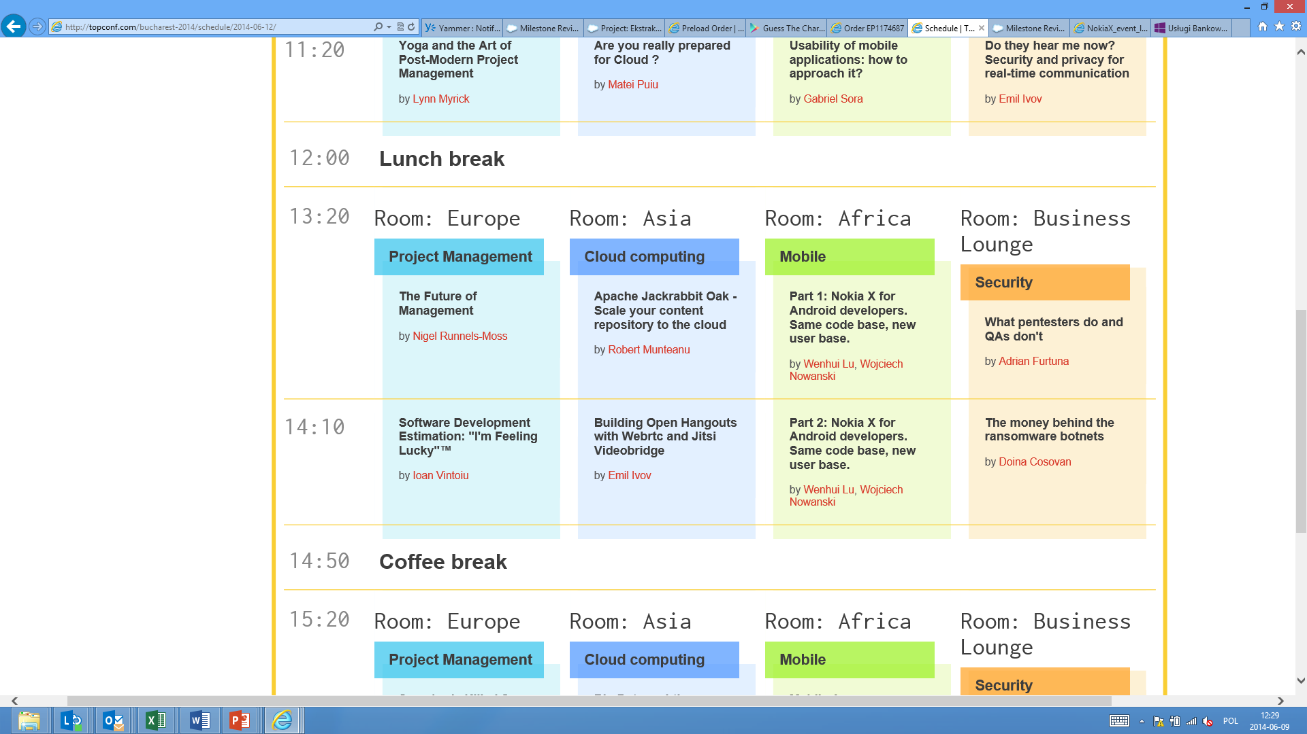

Join us today
Nokia X for Android developers. Same code base, new user base, Mobile Stream Room: Africa, 13:20
Nokia booth at the hall
Nokia porting room
developer.nokia.com

Slide 57

Port your apps! Win a prize!
Port your Android apps to Nokia X
Publish your apps to Nokia X
Be rewarded - the most active developers who will port and publish their Android apps to Nokia X will get a chance to get a Nokia X and other rewards.
developer.nokia.com

Slide 58
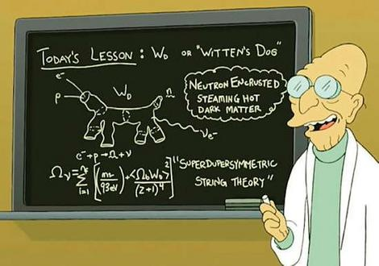
Join us tomorrow on Azure workshop!
Starts at 10AM, agenda :
”Boost your startup with Microsoft Ventures”
Running Linux - tips, trick and best practices
Deep dive into Php and MySQL
Don’t forget to bring your laptops!
We will do hands-on practice!

Slide 59







Online resources
msopentech.com
Open technologies in CEE
opennessatcee.com
CEE Azure user group in Facebook
aka.ms/azure-cee
Last new in our twitter
@azure_cee
Open technologies in CEE
@OpennessAtCEE
All questions about Azure in CEE
azure_cee@microsoft.com

Slide 60


